Slide 1
Notes:
[Blank slide] … preptalk about the experiment …

Slide 2
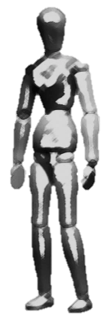
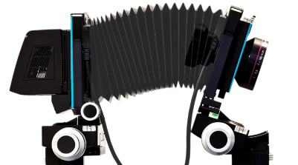
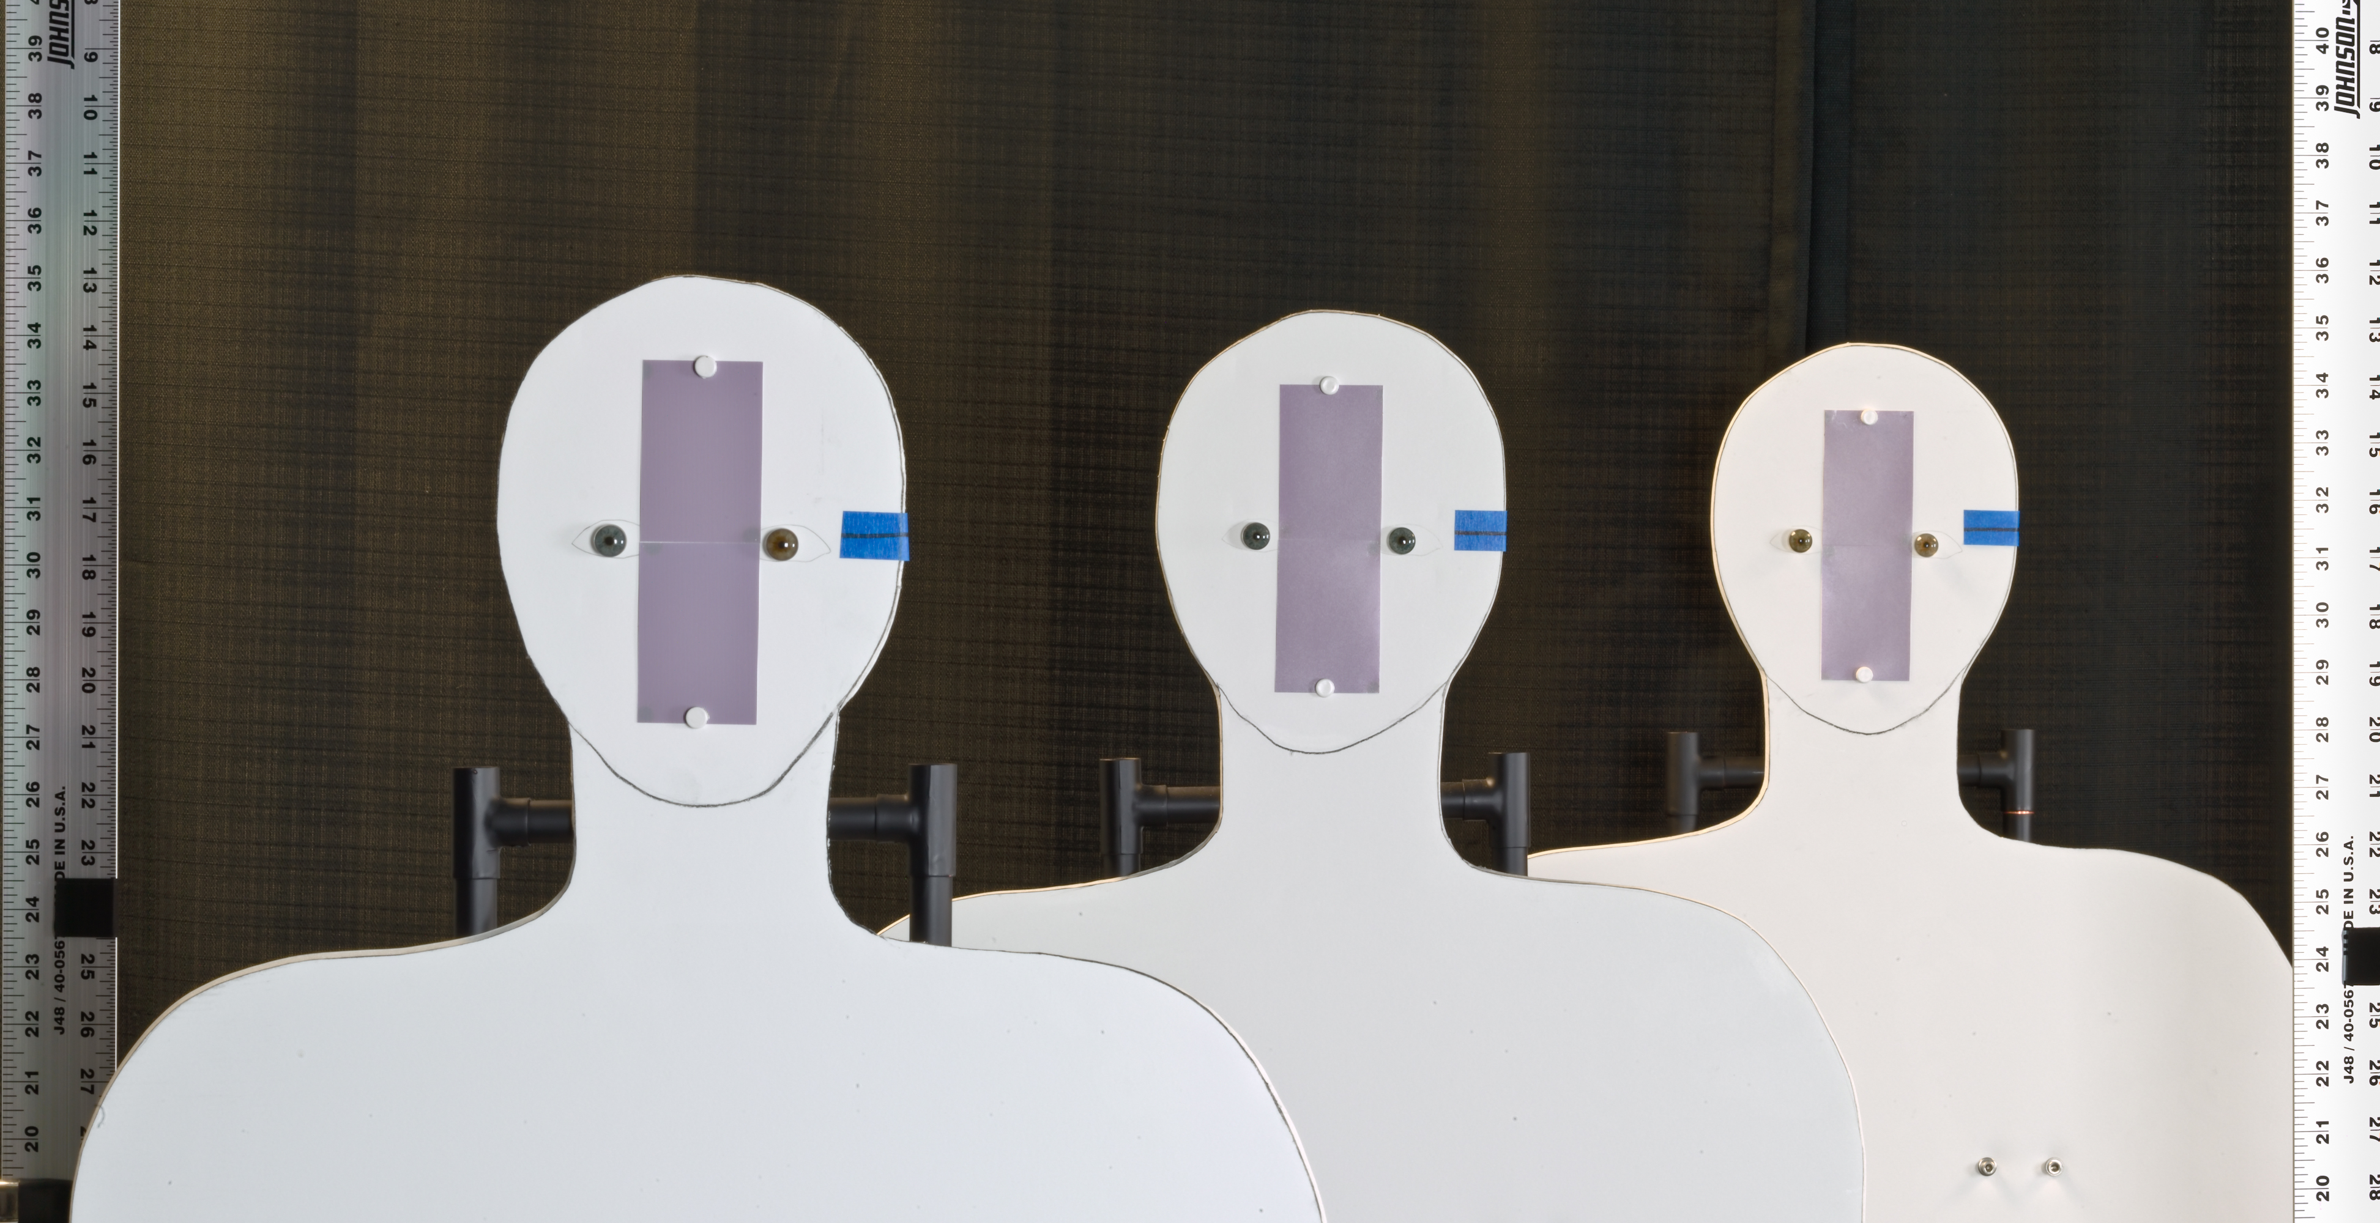
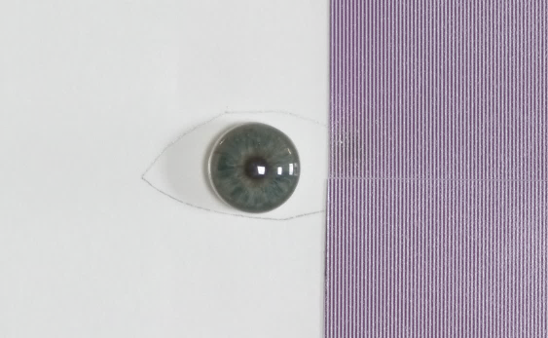
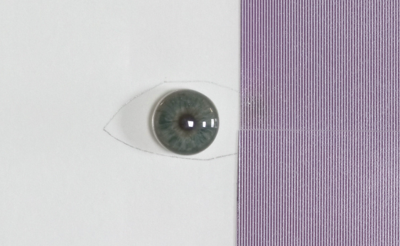
Demonstration of capture volume improvement using AFS in the laboratory
0.61 m
0.61 m
4.04 m
Setup #1
rear
middle
180 mm, F/8
near
Artificial iris
3.43 m
4.04 m
4.65 m
Ø 11 mm
Camera’s view
Pattern (2 lp/mm)
mm

Slide 3
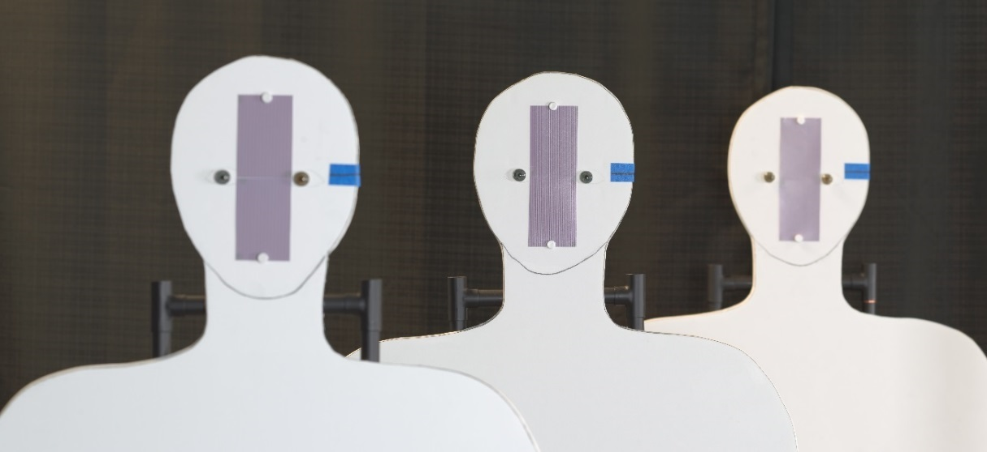
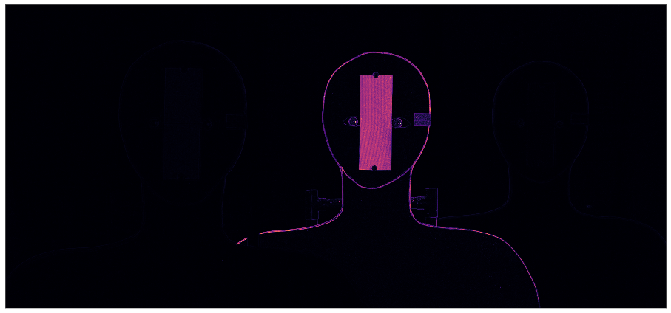
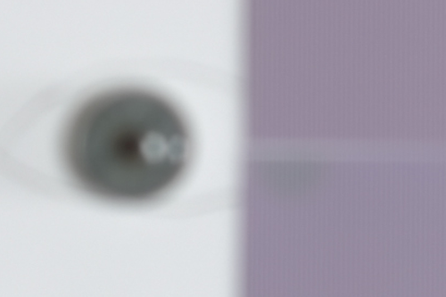
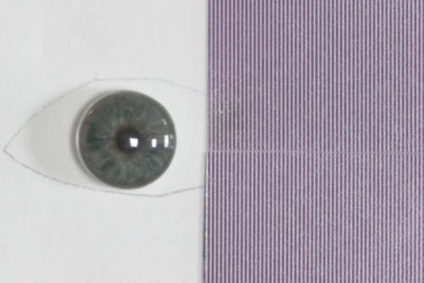
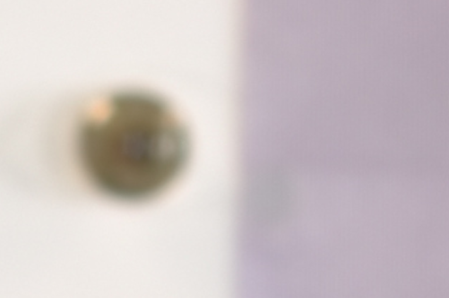
Traditional image capture with large aperture results in shallow DOF
Aperture: F/8 Exposure time: 0.77 sec Focused on: 4.04 m DOF: approx. 30 cm (for 2 lp/mm)
3.43 m
4.04 m
4.65 m
Focus measure
Notes:
Mention that the patches has been scaled differently to match ???

Slide 4
Strategy for capture AFS images
180 mm, F/8 lens tilted b/w -16° & -19° in increments of 0.5° about the entrance pupil center
Notes:
How to determine the angles
How to determine the image plane distance
How to determine
A line on how to restore the COP …
Empirically we found d = -5

Slide 5
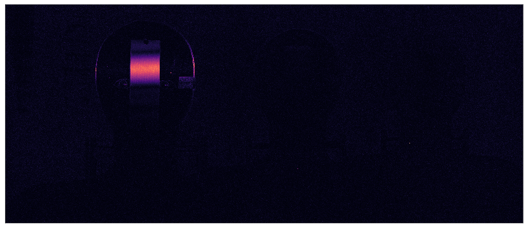
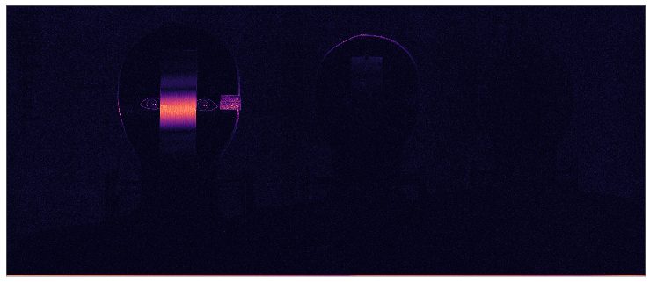
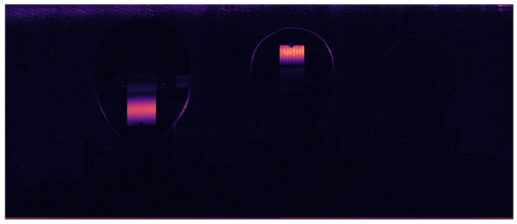
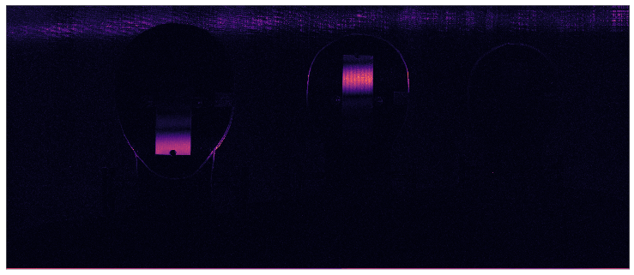
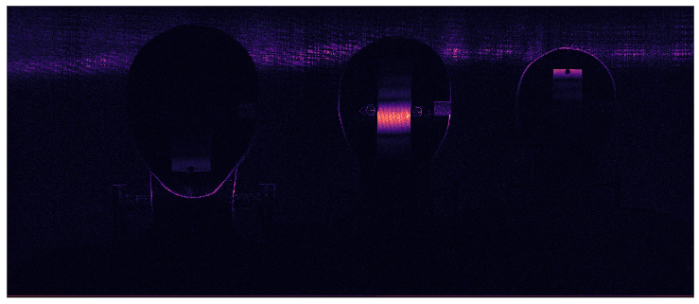
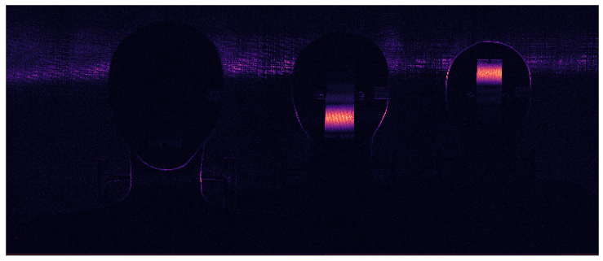
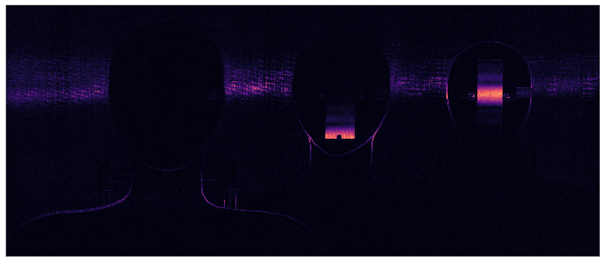
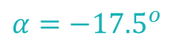
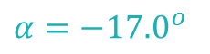
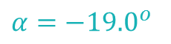
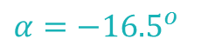
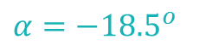
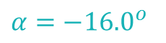
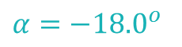
Focused regions in the images detected using LoG filter shows different regions of the scene in focus
$$α=−{16.0}^{o}$$
$$α=−{16.5}^{o}$$
$$α=−{17.0}^{o}$$
$$α=−{17.5}^{o}$$
$$α=−{18.0}^{o}$$
$$α=−{18.5}^{o}$$
$$α=−{19.0}^{o}$$
Notes:
Mention that these are “registered” images in the focal stack

Slide 6
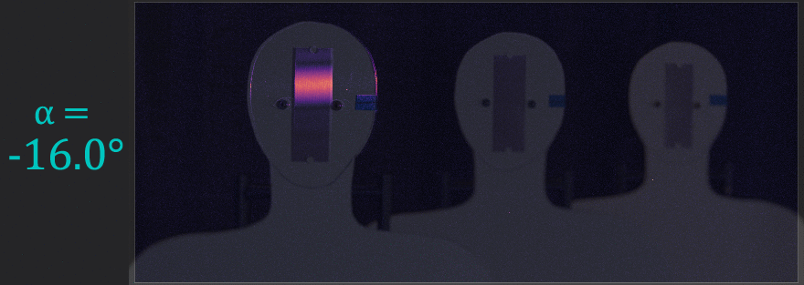
The focused regions overlaid on intensity images shows
rotating the lens induces a rotation of the DOF in the object space

Slide 7
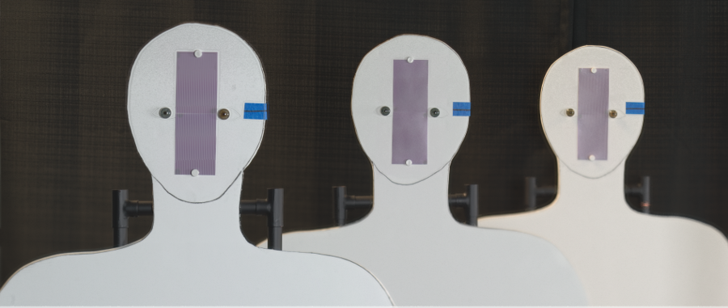
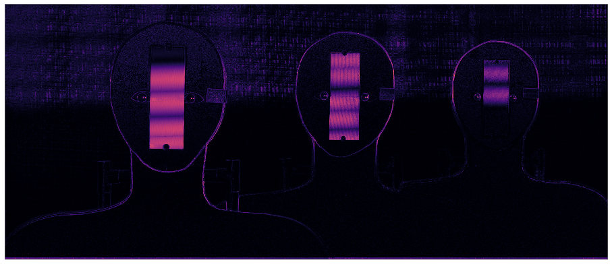
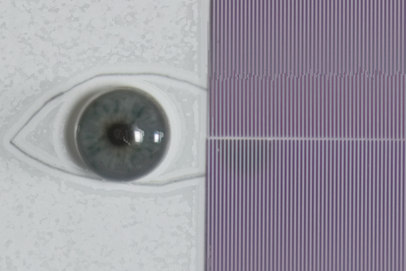
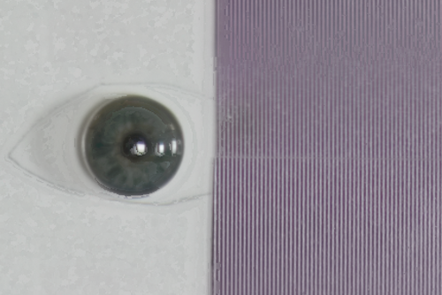
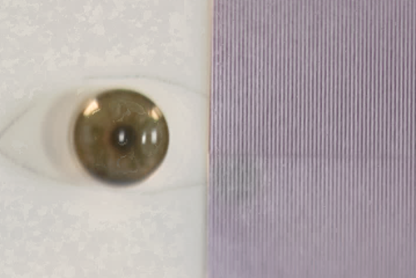
AFS composite image shows DOF extended beyond 1.2 meters
Aperture: F/8 (each image) Total exposure time: 5.4 sec DOF: greater than 1.2 m (for 2 lp/mm)
3.43 m
4.04 m
4.65 m
Focus measure
Adjustment errors causes registration errors
Notes:
Talk about the registration errors arising from the uncertainties of the experiment.

Slide 8
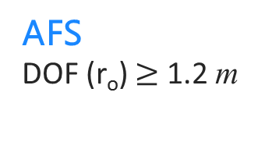
AFS produces at least 4x more DOF than conventional imaging
for a r_{o} = 2 lp/mm target at 4 m
Near (3.43 m)
Middle (4.04 m)
Far (4.65 m)
Conventional at F/8
DOF (r_{o}) = 29 cm
AFS
DOF (r_{o}) $≥$ 1.2 m
Notes:
Mention that the patches has been scaled differently to match ???

Slide 9
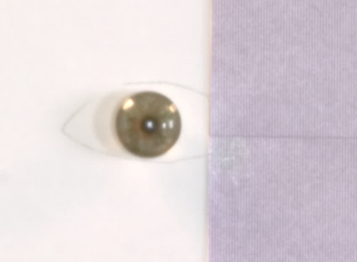
AFS is faster than conventional capture for equivalent DOF & exposure level. Therefore, subjects are less constrained within the extended capture volume.
Near (3.43 m )
Middle (4.04 m )
Far (4.65 m )
Conventional at F/22
T = 8 sec.
AFS
Total T = 5 sec.
Each T = 0.77 sec.
Notes:
Since the main comparision here is for the total time … I can probably scale the images of the eye patches

Slide 10
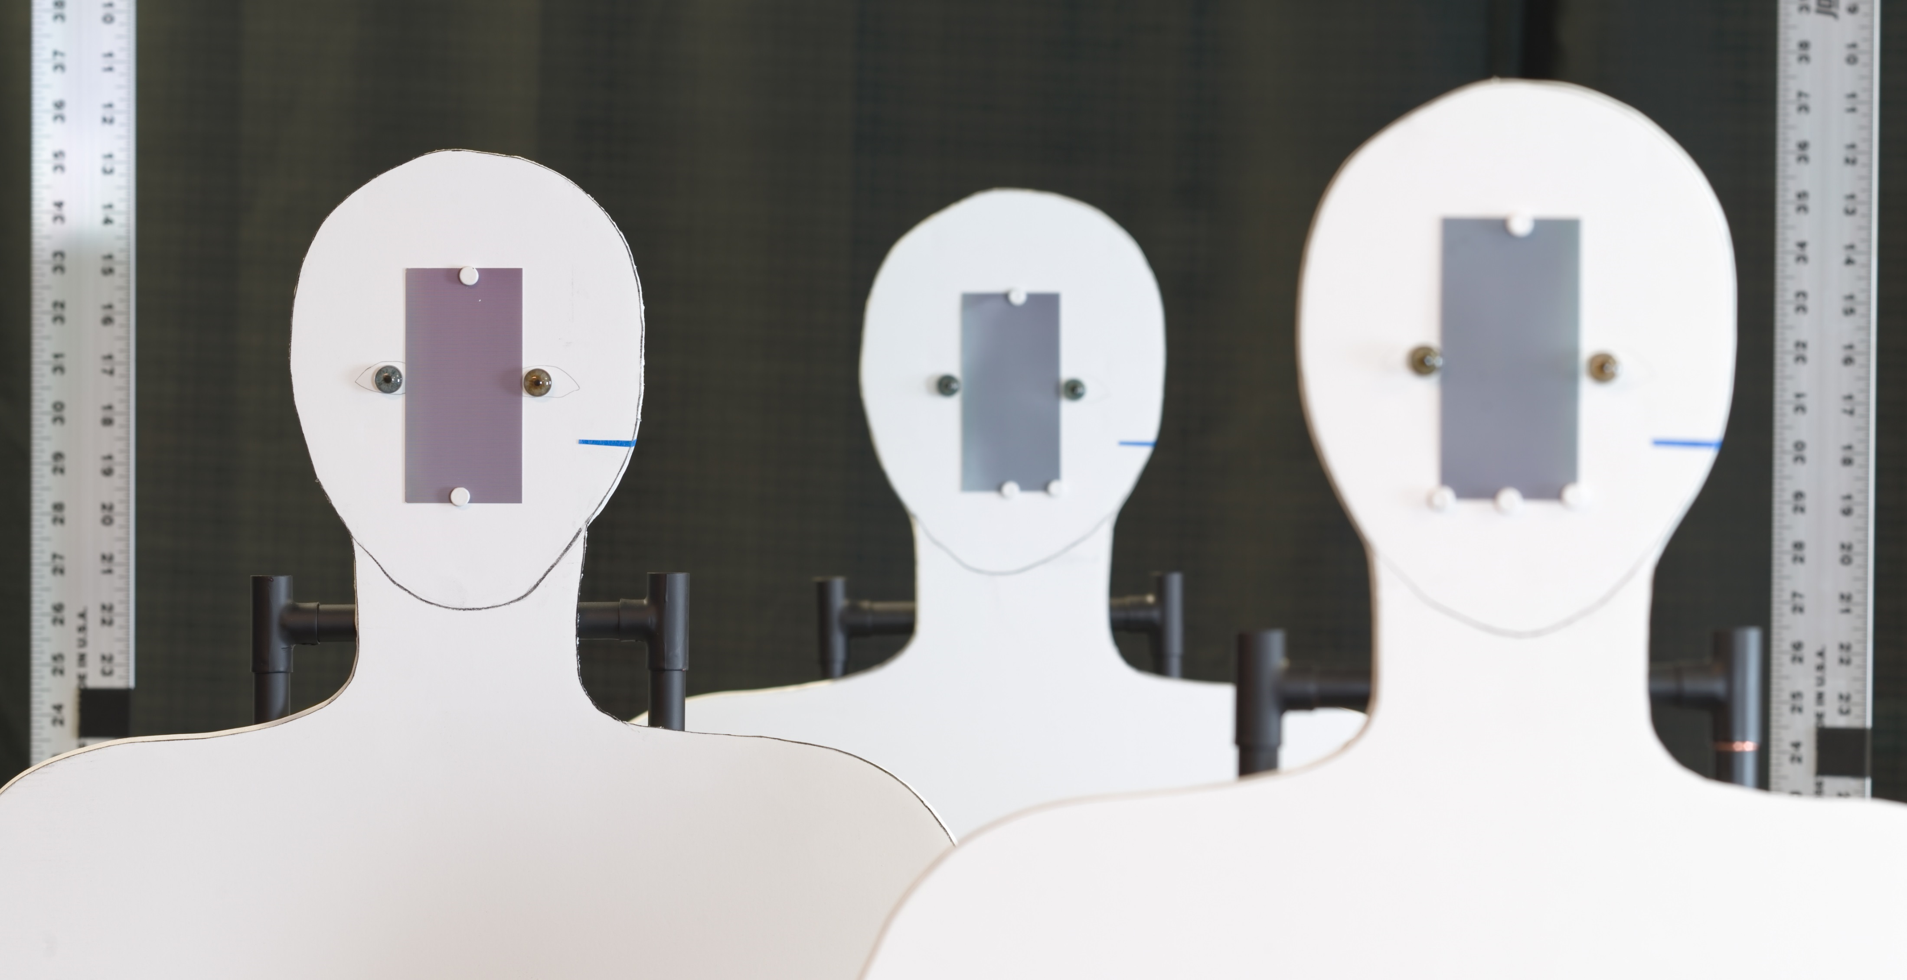
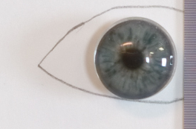
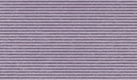
Could we push a
0.61 m
0.61 m
0.61 m
0.61 m
4.04 m
3.43 m
Setup #2
Setup #1
rear
middle
near
180 mm, F/8
rear
middle
near
3.43 m
4.04 m
2.82 m
Artificial iris
Ø 11 mm
Camera’s view
Pattern (3.94 lp/mm)

Slide 11
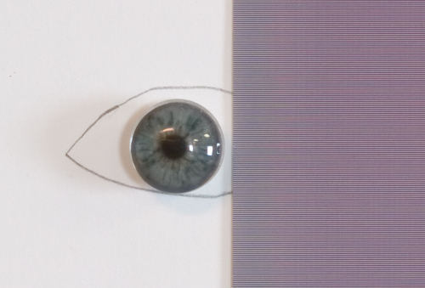
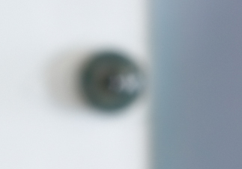
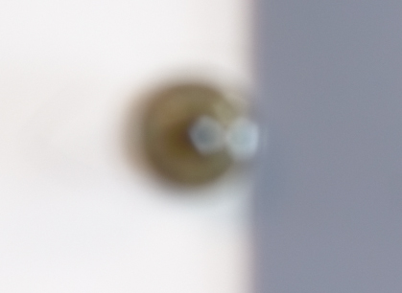
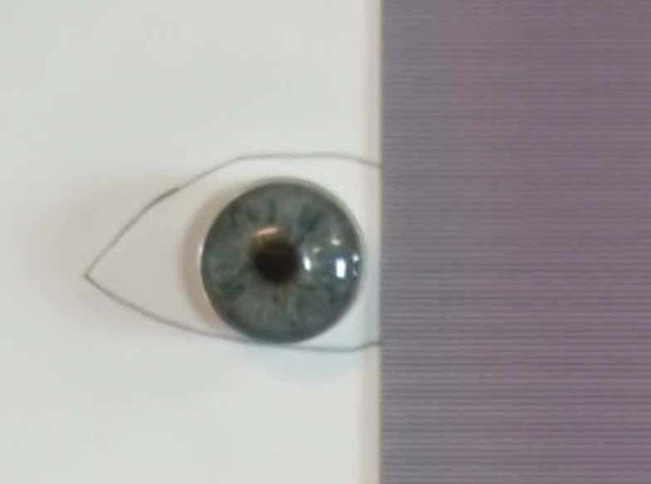
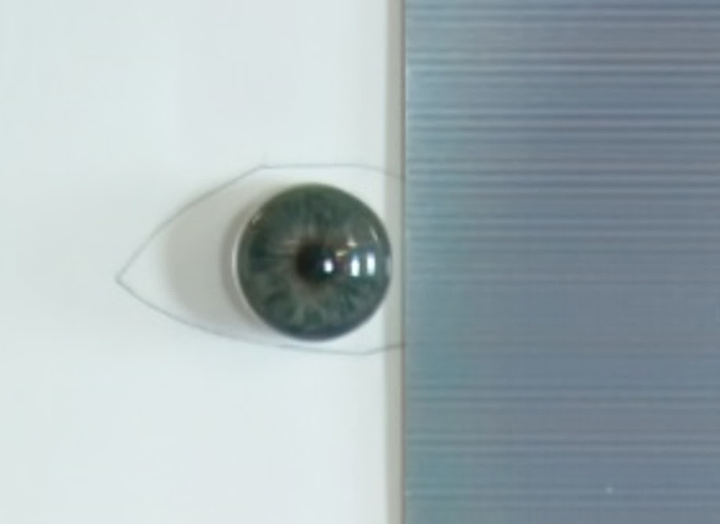
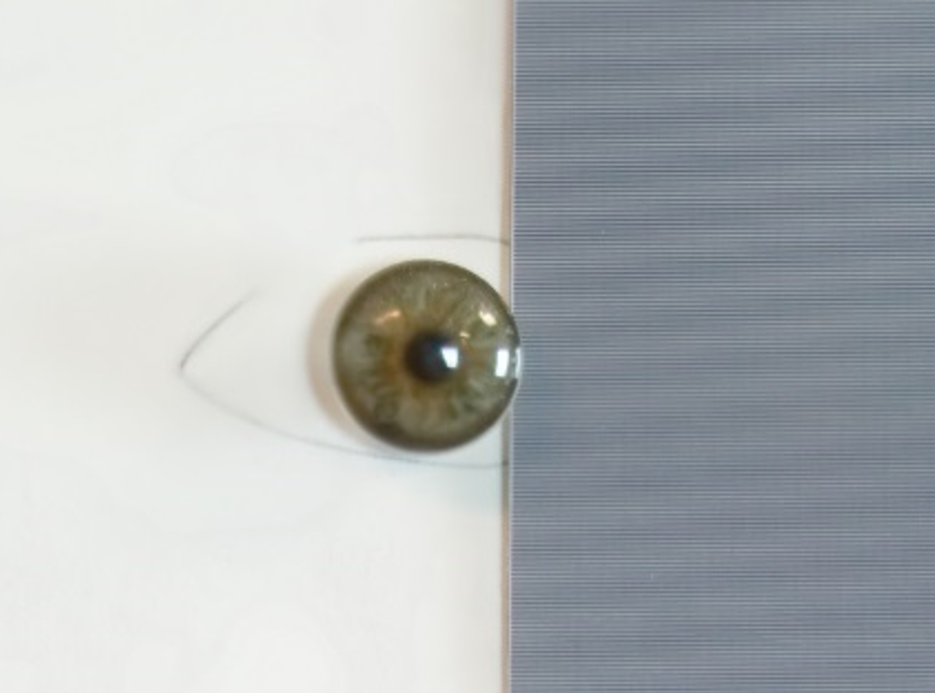
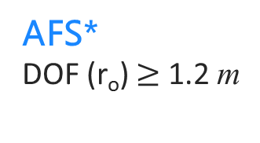
AFS with 14 focal stack images resulted 9.8x DOF than conventional imaging
for a r_{o} = 3.94 lp/mm target at 3.43 m
Middle (3.43 m)
Far (4.04 m)
Near (2.82 m)
Conventional at F/8
DOF (r_{o}) = 12.5 cm
AFS*
DOF (r_{o}) $≥$ 1.2 m
*In this example, the focal stack images, after registration, were fused using Helicon focus.
Notes:
Mention that the patches has been scaled differently to match ???

Slide 12
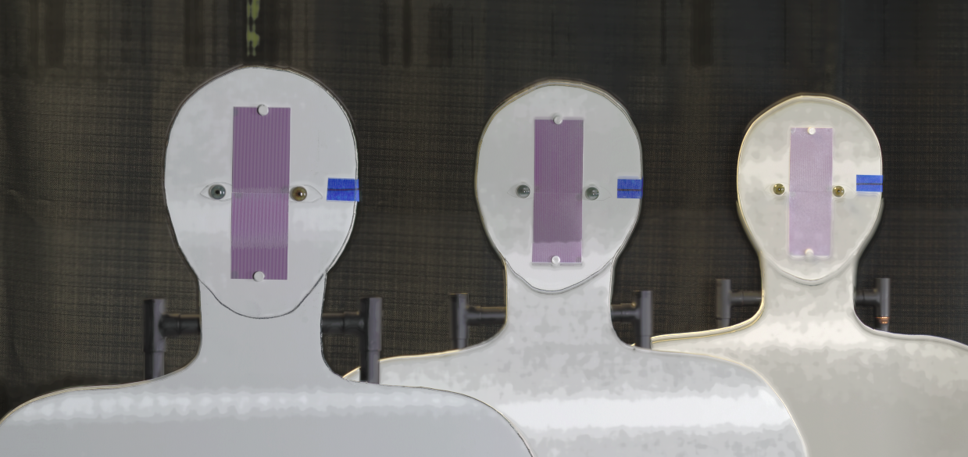
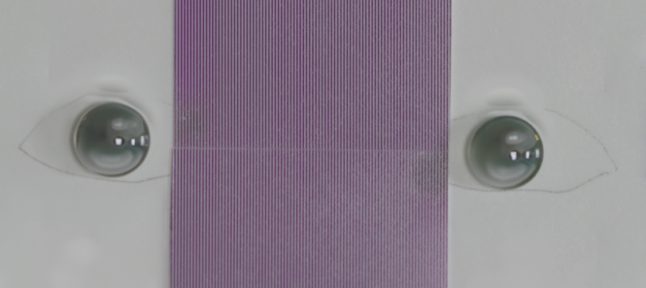
Automatic registration and image fusion fails if the lens is not rotated about the center of the entrance pupil
Output of Helicon focus

Slide 13
We can concluded that.
Plemmons et. al, Wavefront coding
6x
Hsieh et. al, Wavefront coding + PTZ
3x
Yoon et. al, Wavefront coding + PTZ
3x
Venugopalan et. al, PTZ + Video
AFS
9.8x
AFS
4x
Notes:
Conclusion from the slide
Two parts (horizontally separated)
Just two sets of horizontal bar plots.
Compared to conventional imaging | Compared to the state-of-the art
How much DOF extension
Better in

